Slide 1
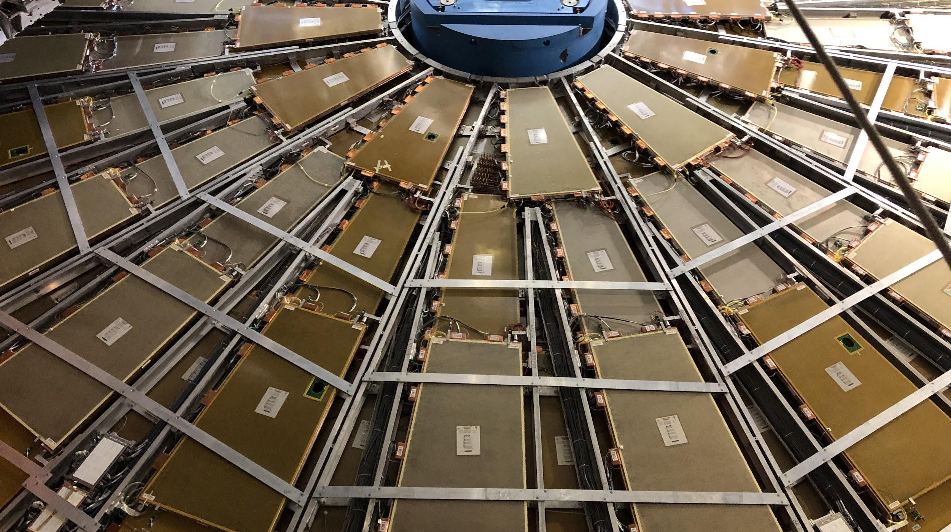

Maintenance Weekly
TileCal Op Meeting, 4 November 2021
Irakli Minashvili, Chris Thomas, Dawit Belayneh, Katie Hughes

Slide 2
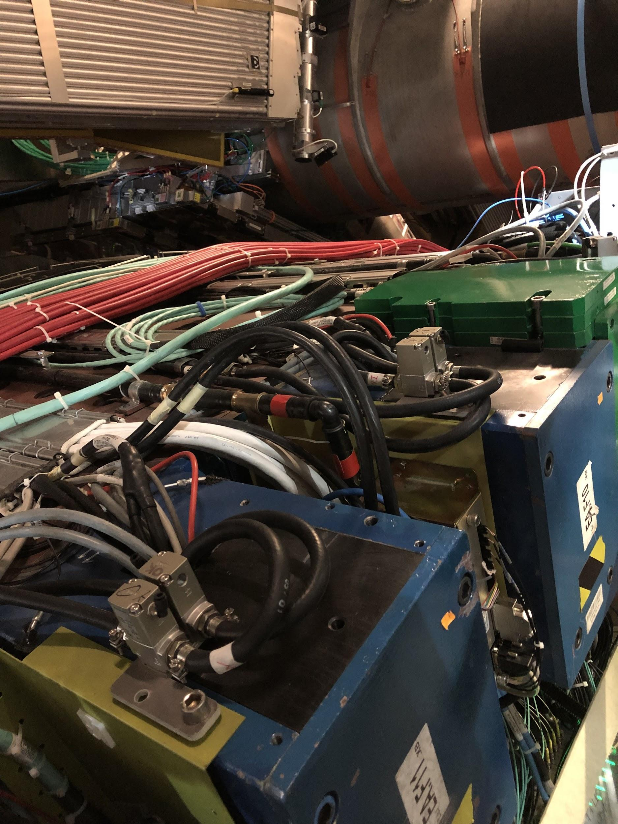
Isolation Valves Update
Began installing and connecting valves on EBA this week
Connected: EBA 05, 06, 07, 09, 10, 11, 12, 13, 15, 16, 17, 18, 19, 20, 22, 23 (top half of detector)
Currently working on the bottom half of the detector (~EBA 40-50)
All loops are turned off

